Slide 1
SAP System monitoring
By
Debdeep
Vineet
Ronak
Kowshika

Slide 2
What is system monitoring ?
System monitoring is a daily activity to check the system activities wheather the activities are performing correctly or not.
System monitoring also involves proactive system monitoring of SAP system helps to understand issues in advance and take corrective actions .
System monitoring increases the system performance and profitability of the business organisation.

Slide 3
Some system monitoring tasks
ABAP dumps analysis
Monitoring system logs
Work process monitoring
Overview of job selection

Slide 4
Some Transaction Codes
Transaction | Purpose
SM21 | Analyzing System logs
ST22 | ABAP dumps analysis
SM50 | Check work processes
SM37 | Overview of job selection
SM51 | SAP server overview

Slide 5
SM21
This T-code is used for online system log analysis .
The SAP System logs is the all system errors, warnings, user locks due to failed log on attempts from known users, and process messages in the system log.
In case of issues like update failure, lock table overflow, spool overflow, operating system issues, network issues, table space full issues and other database issues system log will get updated with the error message and the relevant time stamp. By using this timestamp and error message, basis administrator can identify the cause for the issue and can fix the issue.

Slide 6
Analyzing system logs in SM21

Slide 7
ST22
This T-code is used to analyse ABAP runtime errors
We can use the tools of the ABAP dump analysis (ST22) to list the ABAP runtime errors that have occurred in an ABAP system

Slide 8
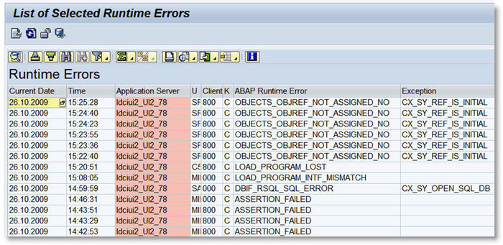
List of selected runtime errors

Slide 9
SM50
This T-code is used to monitor and manage the workprocesses.
In this transaction code we can check the work processe and even cancel it if some work proccesses which are unwanted or taking too long time which are causing your system to work properly. Some times due to too many processes the system become slow.

Slide 10
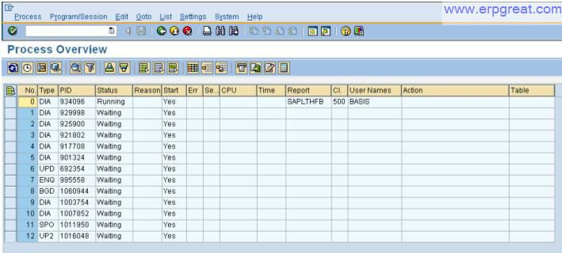
SM50 Screen overview

Slide 11
SM37
This t-code is used to monitor background jobs
Monitoring background job is important because once you schedule the job it might be canceled due to some error. To investigate the root cause use SM37.

Slide 12
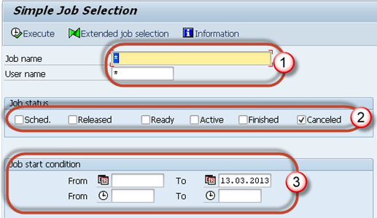
SM37 Screen Overview
Job name and username(who scheduled the job).
You can put * to get details of all jobs scheduled
by all the users.
2. Select job status which you want to monitor.
If you want to find that a background job is not
completed, select Canceled status.
3. Put the date range as per your requirement

Slide 13
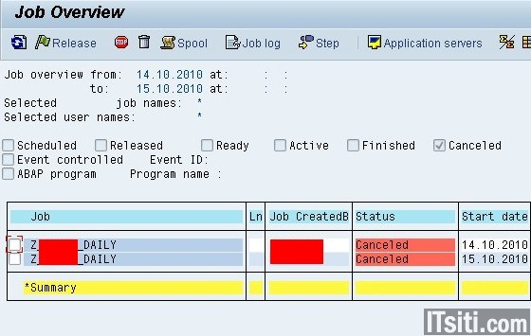
Canceled jobs overview

Slide 14
Various Job Status
Scheduled - Job already been defined, but the start condition has not
yet been defined.
Released - All required criteria are fulfilled for job definition.Start condition
is must for the job to be in release status.
Ready - All the required conditions are met to run the job in a background workprocess.
But job scheduler has put the job in the queue because it is waiting for background
workprocess to be free.
Active - Job has started running in the background. We cannot change the status of the job
once it is in Active status.
Finished - Job is executed successfully. It means the desired task is completed without any error.
Cancelled - There are two possibilities for this. The Administrator has forcefully canceled the job or
there might be some issue with job. You can investigate this from Job logs.

Slide 15
SM51
Transaction code SM51 is to display list of active application servers that have registered in the SAP message server
Further, we can manage & display the status, users, work process in all application servers belonging to the SAP System.
Processes: Display & control work process.
User: Display & manage user sessions.
SNC Status: Display SNC status.
Release Notes: Display detailed release information for an application server.
Remote Logon: Log on by any server in the system; you can see the server where you are logged on in the status bar in the second entry from the left.
System Log: System logs.

Slide 16
Some monitoring T-codes
T-codes | Purpose
SM66 | Global Workprocess Overview
AL08 | List of all users logged on to the system globally
SP01 | Output controller
SP02 | Output controller : list of spool request
SPAD | Spool administration

Slide 17
SM66
This transaction code is used to quickly find the potential cause of system performance problem by checking the work process load .
Using the global workprocess overview we can see at a glance
1. The status of each application server
2. The reason why it is not running
3. Wheather it has been restarted
4. The CPU and request runtime
5. The user who has logged on and the client they logged on to.
6. The report that is running.

Slide 18
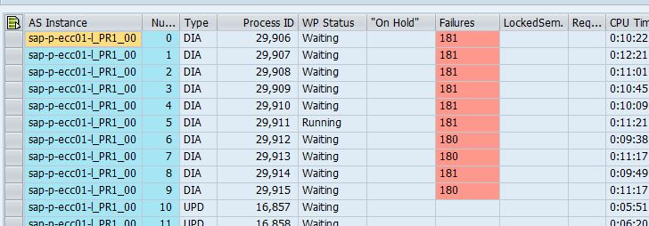
SM66 Screen Overview

Slide 19
AL08
Transaction code AL08 shows the list of all the users who are logged on to the system globally or for all the instances in the system which are active.
It shows :
1. Active Instance
2. Active users logged on to the active Instance
3. Interactive Users – Displays the dialogue users logged on to the active instance .
4. Client No.
5. User Name of Users logged on
6. Terminal – From which terminal or machine user has logged on
7. Transaction Code – Last executed transaction code
8. Time - The time when a user last initiated a dialog step by entering data.
9. External Sessions - Number of External sessions the user has opened.
10. Internal Sessions – Number of internal sessions user has opened.

Slide 20
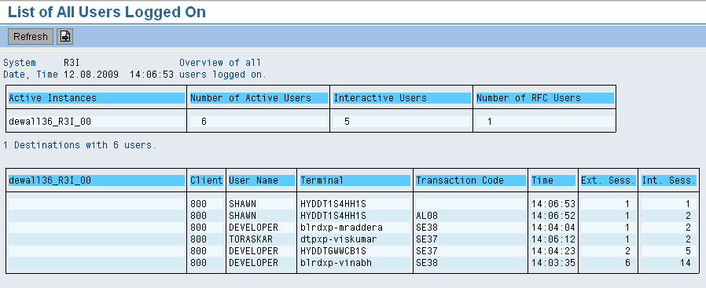
AL08 Screen Overview

Slide 21
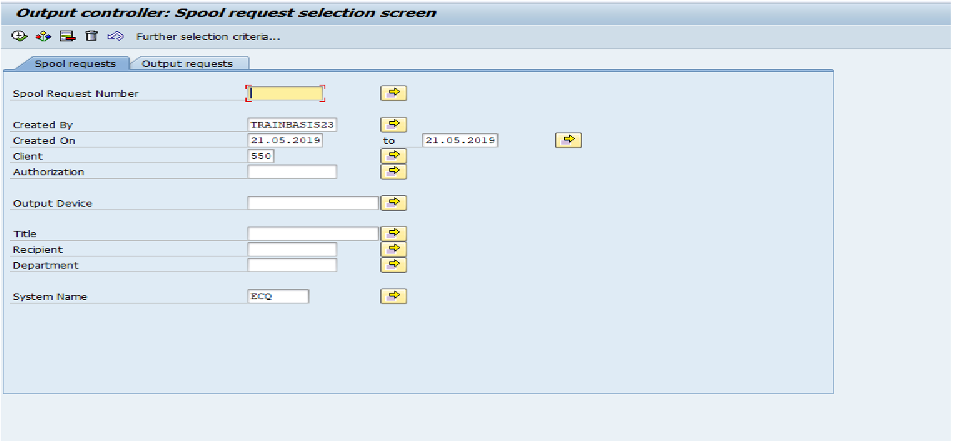
SP01
Spool Request:
Spool request is a request which contains print data without device independent information.
Output request:
Out request is a request which contains the output device information.

Slide 22
SP02
SP02 transaction code is used to display the spool requests directly without selection screen.
With this t-code we can verify the statuses of spool requests. The various statuses are :
Status '-' : Indicates not yet sent to the host system.The spool process is busy/ congested,
if too many requests with this Status indicates need for increasing spool WP.
2. Status '+': Spool request is being generated .
3. Waiting: Waiting for processing by spool .
4. In Process: The spool WP is formatting the output for printing
5. Printing: The host spool is printing the output request. If the SAP spool system does not
receive any status information from the host spool, this status displayed for approximately one minute.
The system then sets the status to Complete (Competed or Error)

Slide 23
SPAD
It is trasaction for SPOOL ADMINSTRATION. Where u can configure the printer settings.
In the SAP system, printers are created in transaction SPAD .
Setting up O/P devices and managing O/P devices.
Setting up and managing spool servers.
Setting up and managing device types.
Setting up and managing management systems.

Slide 24
Few more T-codes
T-codes | Purpose
DB02 | Space Overview
DB12 | Backup logs
ST03N | SAP Workload Monitor
ST06 | Operating System Monitor
ST04 | Monitor database performance

Slide 25
DB02
Transaction code DB02 is to analyze and monitor database statistics like db growth, table space size etc.
1. Check Tablespace size.
  By default, 6 tablespaces were created during installation & need to be monitor from overflows. If PSAP[SID] tablespace size is reaching 95% level, it’s advisable to increase the size.

Slide 26
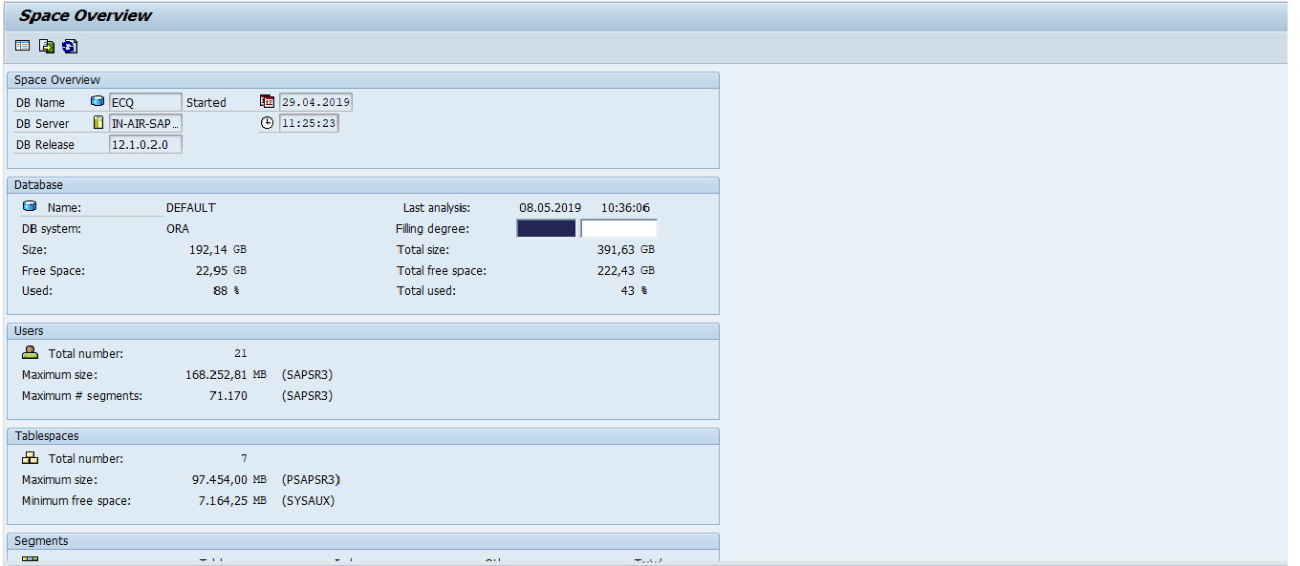
DB02

Slide 27
DB12
Transaction code DB12 is to collect and present information that is necessary to monitor database backups.
On the initial screen of the monitor, it shows overview of important information related to SAP database backups.
  • The last successful backups for the SAP, master and msdb databases and transaction logs.
  • The last SAP database size and duration of the backup job.
  • Whether the SQL Server Agent is started or not.
  • The amount of log space allocated and how much is still free.
  • The Recovery interval, which specifies the maximum time that SQL Server should spend recovering after a database startup.

Slide 28
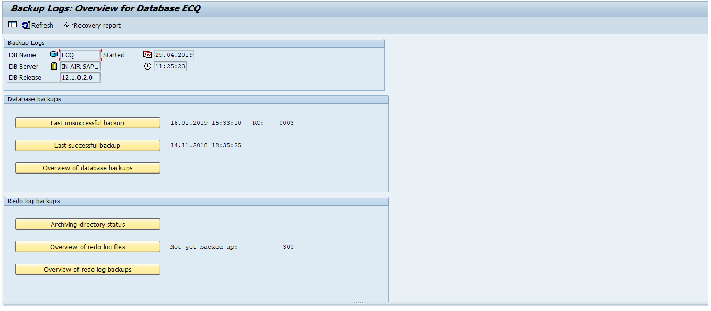
DB12

Slide 29
ST03N
The ST03 Workload Monitor is the central access point for analyzing performance problems in the SAP system. ST03N is a revised version of transaction ST03.
You can use the workload monitor to display the following, among other things:
  1. Number of instances configured for your system
  2. Number of users working on the different instances
  3. Response time distribution
  3. Distribution of workload by transaction steps, transactions, packages, subapplications, and applications
  4. Transactions with the largest response times and database time
  5. Memory usage for each transaction or each user per dialog step
  6. Workload caused by RFC, broken down by transactions, function modules, and destinations
  7. Number and volume of spool requests
  8. Statistics about response time distribution, with or without the GUI time
  9. Optional: table accesses
  10. Workload and transactions used by users, broken down by users, accounting numbers, and clients
  11. Workload generated by requests from external systems

Slide 30
ST06
To exclude performance problems being caused by other components outside the database, you should also use transaction ST06 for analysis. With this transaction you can see whether performance problems are caused by too much strain on the hardware (CPU, RAM).

Slide 31
ST04
Transaction code ST04 is used to shows detail of the database behave & usage, both history and current time.
• Data buffer cache size & quality must be above 95% [meaning less physical read from disk]
• User/Recursive Call > 2 [Recursive call will get more over time]
• Read/User Call < 30 [> 30 means expensive SQL statements]
• Time/User Call < 15ms
• Busy time & CPU time ratio 60:40 ratio. Higher ratio means tuning required
• Sort sections. It should be less than 0.1% of total sorts.
• Shared pool statistics. DD (data dictionary) cache quality should be more than 99%, similarly the SQL area get ratio.
• Instance performance. Soft parse ratio max value is 1 which is not possible because at least once the SQL is hard parsed and then soft parsed in its next executions. But this must be as close as possible to 1 for a healthy system. Similarly there is another fact which is in-memory sort ratio; this is for a healthy system should have higher values. In fact the less the disk sorts the better.

Slide 32
Some more T-codes
T-codes | Purpose
RZ10 | To change static parameters
RZ11 | To change dynamic parameters
RZ04 | Edit operation mode and instances
SM63 | Display or maintain operation modes
SM13 | Administrate Update Records

Slide 33
RZ10
Both RZ10 and RZ11 perform similar tasks, such as permitting the users to modify their profile parameter values.
With RZ10 the change is perpetual and would not restore the previous value even when the system restarts. (Some refer this as a static change)

Slide 34
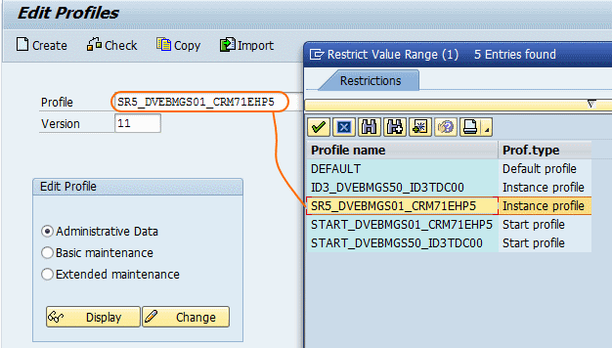
Steps to change parameters in RZ10
Step 1 : Run the T-code RZ10
Step 2 : In next menu select profile from list

Slide 35
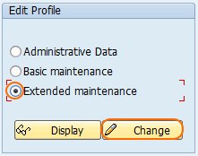
Contd..
Step 3 : Select on “ Extended Maintenance “ to change or create parameters as per your requirements

Slide 36
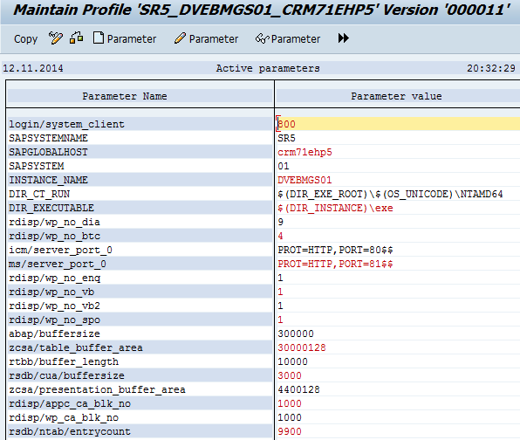
Contd..
Step 4: On maintain profile screen select parameter that you want to modify

Slide 37
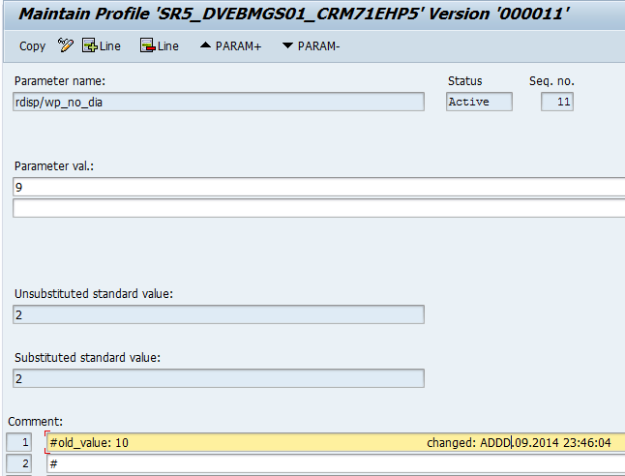
Contd..
Here you can change the parameter value

Slide 38
RZ11
This t-code is used to change parameter dynamically.
When a profile parameter is changed dynamically, the current value of the parameter on the instance or across the system is replaced with the new value
This dynamically changed value is valid for as long as the server is running.
When the application server is restarted, the values from the profiles are re-read and reset. This means that a dynamically changed parameter value is only valid for the runtime of the application server

Slide 39
The following describes how to change the value of a profile parameter dynamically:
Procedure
Call transaction RZ11.
Enter a parameter name.
Click on display .
If necessary, check the current parameter values Choose Change Value from the icon bar.
Enter a new value in window Change Parameter Value.
Click on save .
Confirm the message in the Information window.

Slide 40
RZ04
This transaction code is used to maintain operation modes and instances.
From the initial screen, you can see the operation modes is divided into two modes, Night and Normal. Nightmodes will be during out of office hours (23:00 pm – 06:00 am) and Normal mode will be during office hours (06:00 am – 23:00 pm).

Slide 41
Setting up Operation mode
Start transaction rz04
Click the create button
Enter the operation mode and description.
Click on instance operation mode.
Following screen comes

Slide 42
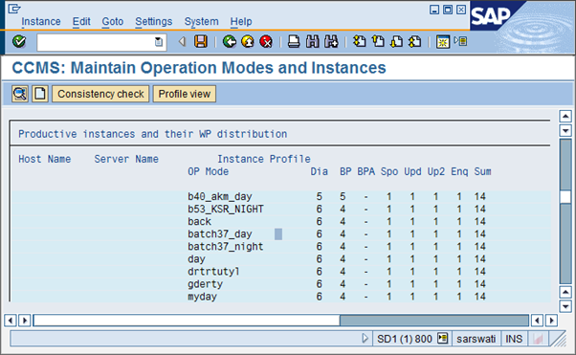
Contd..
double click on any one the following

Slide 43
Contd..
Work process distribution screen will come up .
In that screen click on other operation mode.
Select the created operation mode.
Take the cursor to the back ground and click + or – the way you want the process to be set .
Save it

Slide 44
SM63
This transaction code is used to Display & Maintain Operation Mode Set
Normal Operation : During normal operation, the system repeats the schedule every day, switching operation modes on and off according to the schedule. Use this mode to define your standard operation mode schedule.
Exception Operation : Choose “exception operation” to specify a special one-time operation mode. The system switches to the operation mode only once for the time period that you specify. After the exceptional schedule ends, the system returns to the normal operation schedule. Use this mode to schedule a particular operation mode for a special purpose, such as installing an upgrade.

Slide 45
Steps to display or maintain operation mode
start transaction sm63
Select normal operation.
Press Change
Using the change button , you can specify which operation mode should be chosen for the specific time slot in a 24 hour cycle.
After clicking change button following screen will be openned.

Slide 46
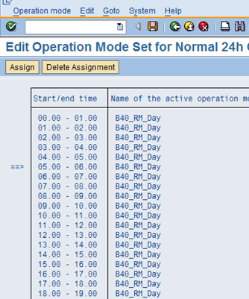
Contd..
First select the Start time to end time.
Select the operation mode you want selected.
Then press save.

Slide 47
SM13
Transaction code SM13 is a update management transaction which is used for:
  Display update requests
  Analyze problems pertaining to the update
  Test and debug canceled update requests
  Display and reset the status of update requests
  Delete update requests
  Display statistics on updates

Slide 48
Conclusion
In the end one can conclude that system monitoring is very important and much needed activity to increase overall system performance.
It’s a kind of activity which requires 24/7 support .
Sap system monitoring helps in two way-
Preventive Health check –This health check helps to prevent issue that may happen in near future e.g. suppose in our system we found database size is 99% full that means anytime in future DB size will bed full and it will lead production outage.
Regular health check-we find most of the work process in sm50 is in priv/stopped mode or some user is taking all system resources / memory. This issue can be solved immediately by killing that user session and releasing memory.

Slide 49


